Slide 1

UEFI, Open Platforms, and the Defender’s Dilemma
CanSecWest 2015 Vancouver, Canada
Vincent Zimmer
@vincentzimmer, vincent.zimmer @intel.com | @gmail.com

Slide 2
Agenda
Background on UEFI
Security Features
Trust Model
EDK II on MinnowMax
EDK II on Galileo
Futures
Notes:
UEFI, Open Platforms and the Defender's Dillema - Vincent Zimmer, Intel This material will be targeted at end-users and parties building the UEFI Extensible Firmware Interface (UEFI) implementations, especially those based upon the open source edk II. The discussion will be a bottoms-up view on building a hardened UEFI-based platform with open source edk II and full-opened source platform code, such as Intel Quark, as motivating example. The talk will discuss the intent behind the UEFI and PI www.uefi.org specifications, along with the open source infrastructure www.tianocore.org, with a full example in Quark https://downloadcenter.intel.com/Detail_Desc.aspx?DwnldID=23197 and open hardware such as MinnowMax https://uefidk.com/content/minnowboard-max. Topics such as measured boot, signed update, UEFI Secure boot, network boot, and best practices in creating both the underlying firmware at boot and runtime. A historical view of some attacks on BIOS, starting circa 1999, and the wave of UEFI-focused attacks, starting 2006, will also be treated, with an eye toward how the best practices can be used to thwart many of these concerns. Finally, as UEFI is a firmware interface and edk II is software, software cannot solely protect software, so some of the extant and purpose-defined hardware features that help in UEFI defenses will also be reviewed.

Slide 3
Background on UEFI

Slide 4
Old Day
Machine
19XX

Slide 5

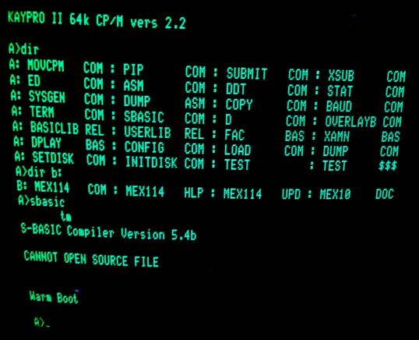
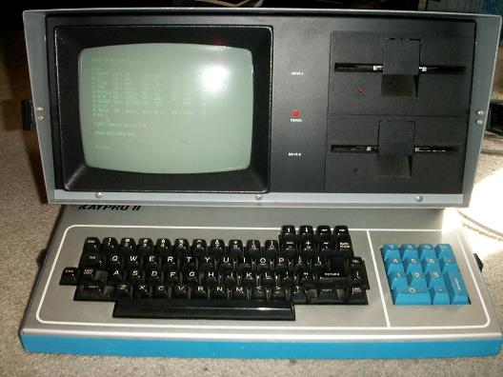
Pioneer
CP/M
BIOS
(machine specific CP/M)
8080/Z80
1974 Basic I/O (Sub) System
by Gary Kildall in CP/M

Slide 6
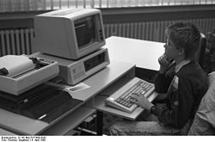
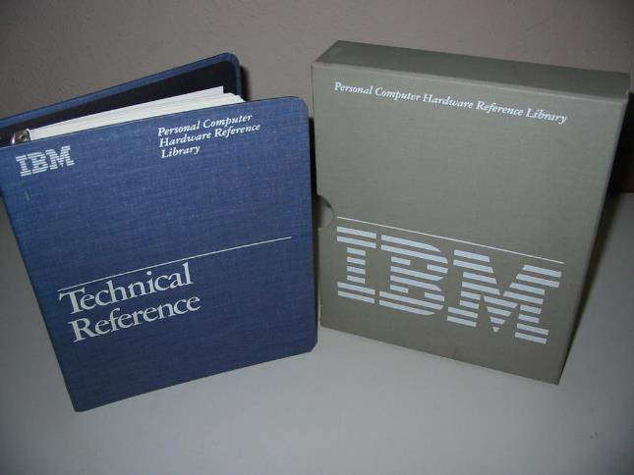
PC/AT BIOS
DOS
BIOS
(de facto standard)
8088
1981 IBM PC

Slide 7
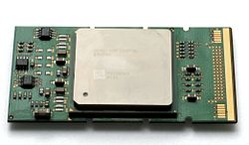
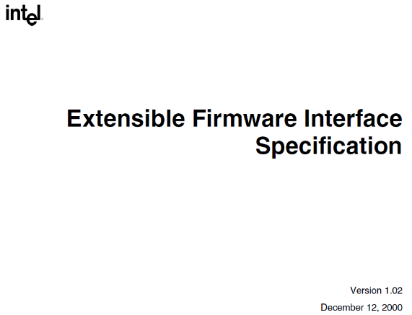
PC/AT BIOS -> EFI
IPF Windows/Linux
EFI
(Intel Standard)
IPF (Merced)
2000 Extensible Firmware Interface
Intel/HP IPF

Slide 8
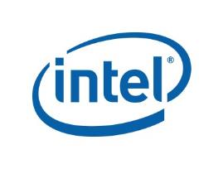











Broader adoption
Windows/Linux
UEFI
(Industry Standard)
IA32/X64/IPF/ARM
2006 January
Unified Extensible Firmware Interface

Slide 9
Today
Windows/Linux
UEFI
PI
UEFI + PI
Generic
UEFI
Drivers
Platform
DXE
Drivers
• • •
CPU
Module
Silicon
Module
• • •
IA32/X64/IPF/ARM
2006 Aug Platform Initialization

Slide 10
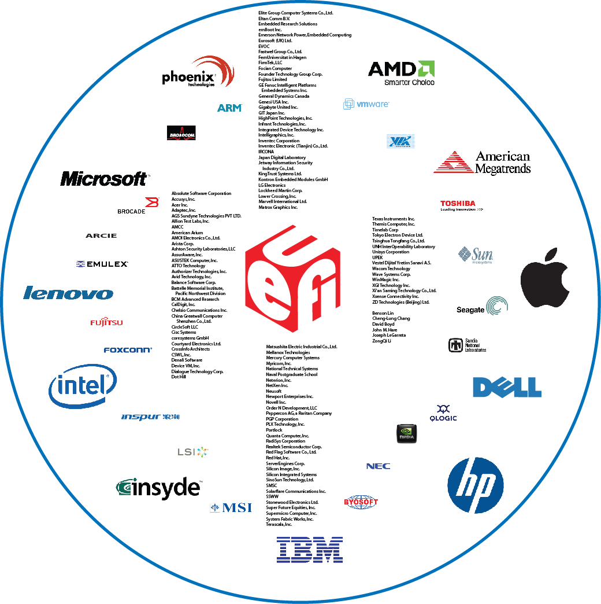
Industry Transition
Pre-2000
All Platforms BIOS were proprietary
Intel invented the Extensible Firmware Interface (EFI) and provided sample implementation under free BSD terms
2000
tianocore.org, open source EFI community launched
2004
Unified EFI (UEFI)
Industry forum, with 11 members, was formed to standardize EFI
2005
2015
240 members and growing!
Major MNCs shipping; UEFI platforms crossed most of IA worldwide units; Microsoft* UEFI x64 support in Server 2008, Vista* and Win7*; RedHat* and SuSEl* OS support. Mandatory for Windows 8 client. ARM 32 and 64 bit support. ACPI added.
Notes:
Prior to 2000, all platforms BIOS have been using a 20+ years old proprietary, monolithic and assembly language based BIOS architecture
Recognizing the problem and opportunity for platform firmware architecture improvement, Intel invented the Extensible Firmware Interface (EFI) architecture and led the industry to make it a standard….and started to provide sample implementation under free BSD terms in 2000
EFI’s architecture is modular, flexible and extensible…and uses higher programming languages (instead of assembly). EFI helps reduce development cost, improve productivity, reduce TTM and enable platform differentiation
The Open Source EFI community “tianocore.org” was launched in 2004….and a year later, the Unified EFI (UEFI) Industry forum was formed to standardize EFI.
The standard is now called Unified EFI (or UEFI).
Back in 2005, the UEFI forum had 11 members only. Today we have over 160 members representing some of the key industry leaders including all Tier 1 MNCs, Microsoft and BIOS vendors. This significant growth is a healthy indicator of the industry’s acceptance and commitment to the standard.
As you will see in the next few slides, not only did the industry come together to establish a platform firmware standard, but UEFI based products are being developed and deployed….and multiple industry data indicates that by 2010 most systems shipping IA will be using firmware based on UEFI.
The tianocore.org open source community has been instrumental to the success and establishment of new standard “platform” in the pre-boot and firmware space.

Slide 11

What is UEFI? UEFI Platform Initialization Overview
Human User
GUI
Pre-boot
Tools
Application
OS
(UEFI or
Today’s)
Libraries
Drivers
Full system stack (user -> hardware)
UEFI Specification
Network
OS
Platform
Drivers
Firmware
Hardware
UEFI 2.4 specifies how firmware boots OS loader
UEFI’s Platform Initialization (PI) 1.3 Architecture specifies how Driver Execution Environment (DXE) Drivers and Pre-EFI Initialization (PEI) Modules (PEIMs) initialize SI and the platform
DXE is preferred UEFI Implementation
PEIMs, UEFI and DXE drivers implement networking, Update, other security features
UEFI PI Scope - Green “H”
Silicon
Component
Modules
Hardware
PEI/DXE PI Foundation
Modular components

Slide 12
Where are we (UEFI firmware)?
VM
VM
App
App
App
App
OS
OS
BIOS & OS/VMM share access, but not trust
UEFI + PI SMM
VMM / Hypervisor
SMM / BIOS
Privilege
Hypervisor can grant VM direct hardware access
CPU
Memory
Peripherals
Firmware
Hardware
A specific Peripheral may have its own processor, and its own firmware, which is undetectable by host CPU/OS.
Platform
DMA
Notes:
Specific examples

Slide 13
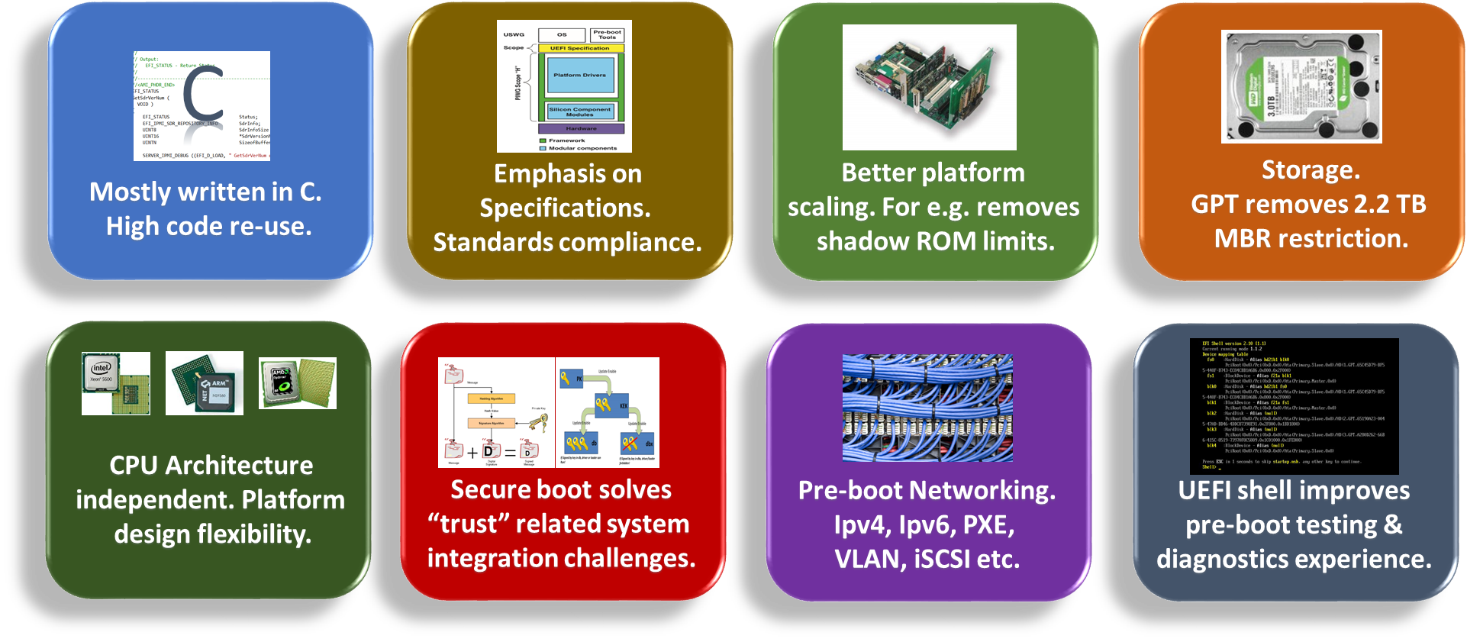
What’s in UEFI

Slide 14
Startup
TempRam
UEFI Interfaces Boundary
for PM_AUTH/
EndOfDxe Event
OS-Absent App
PEI Core
UEFI Shell
CPU Init
Device, Bus, or Service Driver
Chipset Init
Transient OS Boot Loader
Board Init
OS-Present App
EFI Driver Dispatcher
Boot Manager
Architectural Protocols
Final OS Boot Loader
Final OS Environment
Security (SEC)
Pre EFI Initialization (PEI)
Driver Execution Environment (DXE)
Boot Dev
Select (BDS)
Transient System Load
(TSL)
Run Time
(RT)
Power on
[ . . Platform initialization . . ]
[ . . . . OS boot . . . . ]
Shutdown
OEM/PM extensible
3rd party extensible
Overall UEFI Boot Timeline

Slide 15
UEFI [Compliant] Firmware
CPU Reset
SEC
S-CRTM; Init caches/MTRRs; Cache-as-RAM (NEM); Recovery; TPM Init
Pre-EFI Init (PEI)
S-CRTM: Measure DXE/BDS
Early CPU/PCH Init
Memory (DIMMs, DRAM) Init, SMM Init
Driver Exec Env (DXE)
Continue initialization of platform & devices
Enum FV, dispatch drivers (network, I/O, service..)
Produce Boot and Runtime Services
Boot Dev Select (BDS)
Boot Manager (Select Boot Device)
EFI Shell/Apps; OS Boot Loader(s)
ACPI, UEFI SystemTable, SMBIOS table
Runtime / OS
ExitBootServices. Minimal UEFI services (Variable)

Slide 16
Specification & Tianocore.org Timeline
http://uefi.org
UEFI 2.0
UEFI 2.1
UEFI 2.2
UEFI 2.3
UEFI 2.3.1
UEFI 2.4
PI 1.0
PI 1.1
PI 1.2
Specifications
Shell 2.0
Packaging 1.0
PI 1.3
ACPI5.1
2006 | 2007 | 2008 | 2009 | 2010 | 2011-14
SCT UEFI 2.0
SCT UEFI 2.1
SCT UEFI 2.3
EDK 1.01: UEFI 2.0
EDK 1.04: UEFI 2.1
PI 1.0
EDK 1.06: UEFI 2.1+
PI 1.0
FSP1.0
Implementation
SCT
PI 1.0
EDK II*: UEFI 2.1+
PI 1.0
UDK2010: UEFI 2.3
PI 1.2
UDK2014
UEFI 2.4
PI 1.3
http://tianocore.org SourceForge.net
All products, dates, and programs are based on current expectations and subject to change without notice.

Slide 17

USWG
UEFI Specification Working Group
PIWG
Platform Initialization Working Group
ASWG
ACPI Specification Working Group
BOS
Board Of Directors
USST
USWG Security Sub-team
Chaired by Vincent Zimmer (Intel)
Responsible for all security related material and the team that has added security infrastructure in the UEFI spec
USRT
UEFI Security Response Team
Chaired by Dick Wilkins (Phoenix)
Provide response to security issues.
UNST
UEFI Network Sub-team (VZ chairs, too)
Evolve network boot & network security infrastructure for UEFI Specification
www.uefi.org
ASWG, PIWG
BOD
USRT
USWG
UNST
USST
……
Note: Engaged in firmware/boot
Related WG’s of Trusted Computing Group (TCG), IETF, DMTF
Working Groups in UEFI

Slide 18
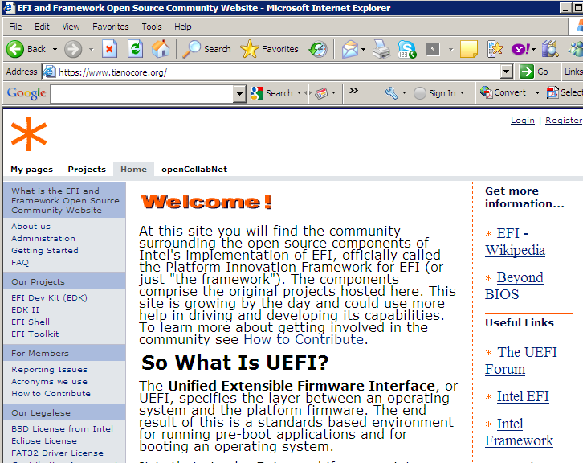
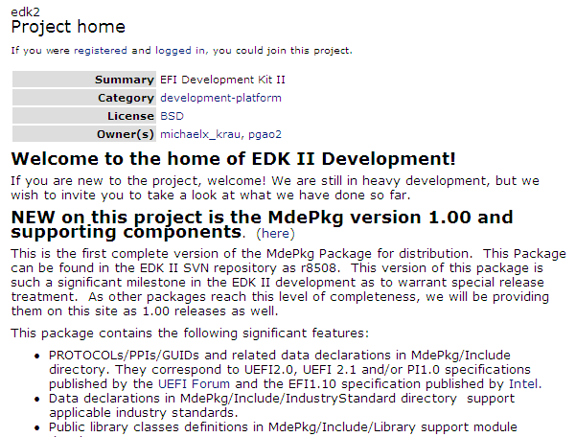
UDK2014 Available on Tianocore.org

Slide 19
How to build it? UDK2014
Industry Standards Compliance
UEFI 2.0, UEFI 2.1, UEFI 2.2, UEFI 2.3, UEFI 2.4; PI 1.0, PI 1.1, PI 1.2, PI1.3, ACPI 5.1
Extensible Foundation for Advanced Capabilities
Pre-OS Security
Rich Networking
Manageability
Support for UEFI Packages
Import/export modules source/binaries to many build systems
Maximize Re-use of Source Code**
Platform Configuration Database (PCD) provides “knobs” for binaries
ECP provides for reuse of EDK1117 (EDK I) modules
Improved modularity, library classes and instances
Optimize for size or speed
** benefit of EDK II codebase
Multiple Development Environments and Tool Chains**
Windows, Linux, OSX
VS2003, VS2005, WinDDK, Intel, GCC
Fast and Flexible Build Infrastructure**
4X+ Build Performance Improvement (vs EDKI)
Targeted Module Build Flexibility
Maximize the open source at www.tianocore.org
Intel® UEFI Development Kit 2010 (Intel® UDK2010)

Slide 20
Contents
Time
USB1.1
USB 2
USB 3
PCI
PCIe
ACPI 2
ACPI 3
ACPI 4
ACPI 5.1
Since ~2001
UEFI 2.0
UEFI 2.1
UEFI 2.2
UEFI 2.3
UEFI 2.4
PI 1.0
PI 1.1
PI 1.2
EDK I
ECP
Hundreds deep
Today
Sustaining
New dev

Slide 21
Core evolution
1.4
1.1
1.2
1.3
3.1
3.2
3.3
Trunk
1.0
2.0
3.0
4.0
2.1
2.2
2.3
Time
Different branches to support

Slide 22
The road from core to platform
tianocore.org
Open Source
Reference Tree
OEM BIOS
New product
Open Source
Existing product
End users updating?
Commercial product in the field
Consumer product in the field
IBV

ODM BIOS
All
Intel
OEM
IBV
ODM
ODMs updating?
New product
Existing ODM product
Time

Slide 23
Security Features

Slide 24
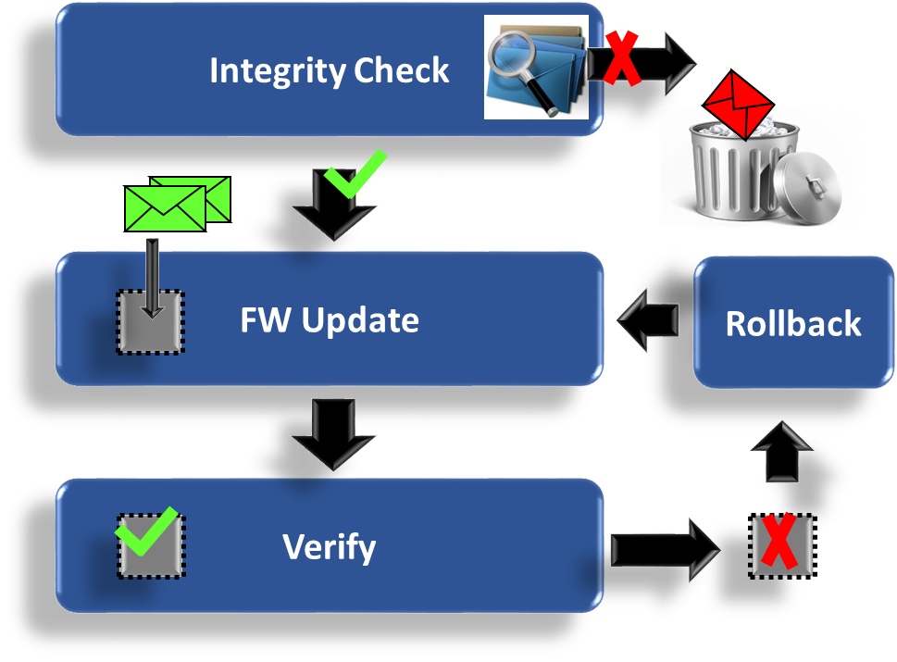
Solving Firmware Update
Reliable update story
Fault tolerant
Scalable & repeatable
How can UEFI Help?
Capsule model for binary delivery
Bus / Device Enumeration
Managing updates via
EFI System Resource Table
Firmware Management Protocol
Capsule Signing

Slide 25
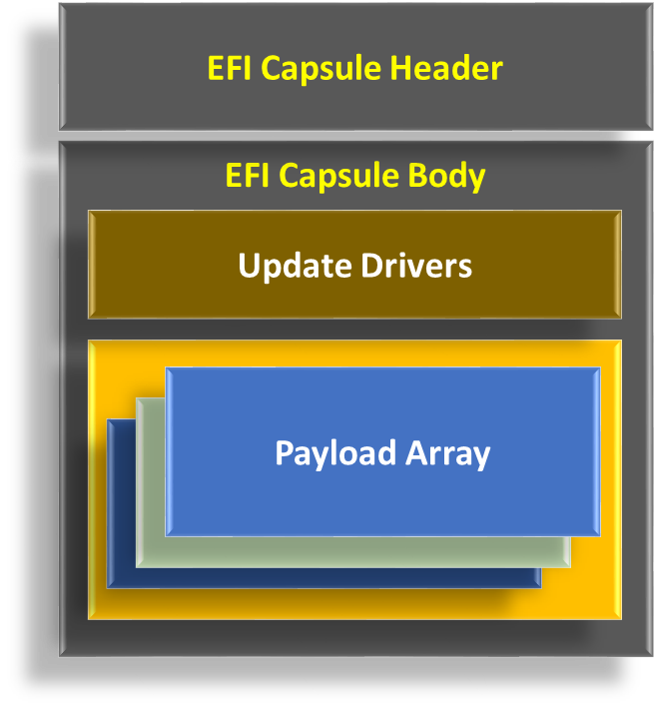
Delivering Firmware Binaries
UEFI supports Capsule format
Tools for capsule generation
Core logic for capsule handling
Extensible Capsule format
Self-contained
Discrete updates
Composite updates
Firmware Management Protocol allows
Reading / updating firmware
Integrity checks

Slide 26
Rollbacks with fences
Version 1
Version 1
Version 1
Version 2
Version 2
Version 2
Version 3
Version 3
Version 3
“Fence”
Each version fixes some issues with the previous. Since none are known to have security flaws, each new version allows updates to all older versions.
Version 4
Version 4
Version 5 can now accept only versions 5 and 4.
In V4, one of the issues fixed in V3 is realized to be a security fix. V4 will not allow updates to earlier versions, even V3 since it allows update to V2.
Version 5

Slide 27
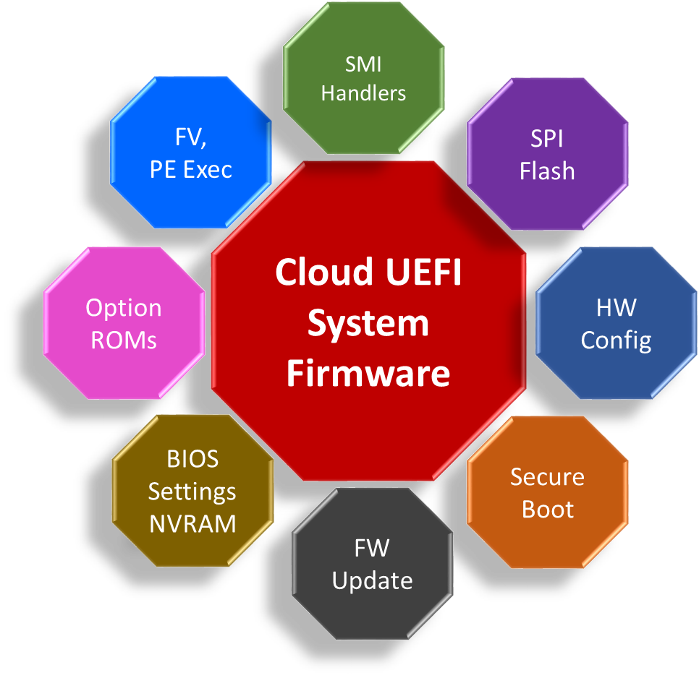
Security Solutions
Signed capsule updates
UEFI Secure boot
local / network
TPM on the platform
Measured boot
Root of Trust for Reporting
Storage
Protect machine configuration & UEFI Secure boot trust anchors
In-band and out-of-band network security

Slide 28
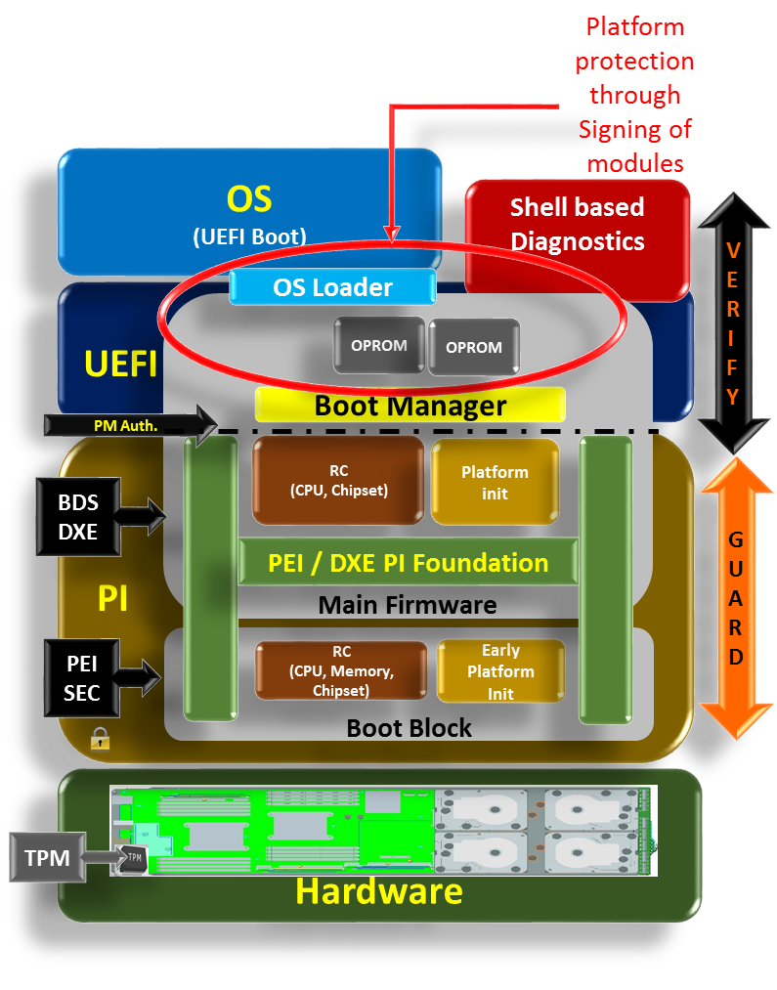
Guarding & Verifying in Pre-boot
PI & UEFI complement each other to impart platform security through guarding and verification during pre-boot.
PI facilitates platform hardening by guarding internal firmware ingredients that consume reset vector, initialization of CPU, Memory, Chipset etc.
UEFI signing allows robust platform scaling through verified inclusion of external firmware ingredients such as OPROMS into the trust chain

Slide 29
UEFI Driver Signing
Why? – Origin & Integrity
How? – Authenticode PE
PKCS#7 +
Authenticode Ext
PE Image
ContentInfo
PE file hash
PE Header
Certificate
Directory
Section 1
……
Section N
Certificate
X.509 Certificate
Type
SignInfo
Signed hash of
ContentInfo
Attribute
Certificate
Table

Slide 30
UEFI Authenticated Variable
PKCS#7
Why? – Integrity (no confidentiality)
How? – Time Based
Authenticated Variable
ContentInfo
N/A
Input Variable Data
Certificate
Authentication
X.509 Certificate
Time Stamp
Type
Certificate
SignInfo
Signed hash of
VariableName +
VariableGuid+
Attributes +
TimeStamp +
DataContent
Data Content

Slide 31
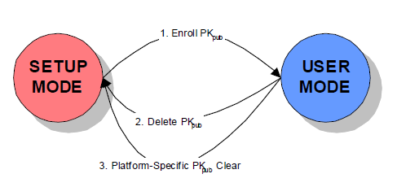
Put them altogether: UEFI Secure Boot

Slide 32
UEFI Secure Boot VS TCG Trusted Boot
UEFI PI will measure OS loader & UEFI drivers into TPM (1.2 or 2.0) PCR (Platform Configuration Register)
UEFI authenticate OS loader (pub key and policy)
UEFI Firmware
UEFI
UEFI OS Ldr, Drivers
Check signature of before loading
Kernel
TPM
record in PCR
Drivers
UEFI Secure boot will stop platform boot if signature not valid (OEM to provide remediation capability)
UEFI will require remediation mechanisms if boot fails
Apps
TCG Trusted boot will never fail
Incumbent upon other SW to make security decision using attestation

Slide 33

PEI FV
1. Enroll
Authenticated Variables
2C. Signed Image Load & Measure to
TPM
OpRom.efi
PK
Certificate
+ SignInfo
KEK
3. Post ship update DB
db
Certificate
2A. Signed Image Discover
dbx
Certificate
Variable
OsLoader.efi
2B. Signature Verification
Certificate
+ SignInfo
DXE FV
Image Verify
UEFI Secure Boot Ceremony-
Ellison, Carl M. “Ceremony Design and Analysis,” IACR Cryptology ePrint Archive (2007): 399. https://eprint.iacr.org/2007/399.pdf

Slide 34
Relevant open source software packages/routines for Authorization flow
See Rosenbaum, Zimmer, "A Tour Beyond BIOS into UEFI Secure Boot,“ for more details
Notes:
1 Authenticate the image’s format and structure.
2 If the image is unsigned: If its signature in in the authorized database (DB) and is not in the forbidden database (DBX), run the image, otherwise deny.
3 If the image is signed, check if its certificate has been authorized (i.e. the image’s certificate is found in the KEK or the authorized database (DB), and is not in the forbidden database (DBX)).
If the image’s certificate is authorized, then unless the image’s signature is in the forbidden database (DBX), run the image
4 If the image’s certificate has not been authorized, then check its signature. If its signature is in the authorized database (DB) and is not in the forbidden database (DBX), run the image, otherwise deny running the image
Signature – is the SHA256 hash of the PE/COFF image.
Certificate – is the image’s Authenticode certificate containing the public key used to sign the image.
Certificate Authorized
In UDK2010.SR1.UP1 and earlier implementations, an image’s certificate is authorized if it matches or chains to a KEK or DB entry, (or both).
However, the UEFI 231C specification now states on page 227 that an certificate in DB can match or chain to certificates in KEK, or PK.
Since certificates in KEK must chain to certificates in PK, this clarification implies that a certificate in DB is authorized if it chains to a certificate in PK.
I.e. during SetVariable, KEK is used to authorize DB (and DBX) variable entries and PK is used to authorized KEK entries. However KEK is not used to authorize an image to be run during LoadImage.
Implementations complying with this updated interpretation authorize an image’s certificate if it matches or chains to only a DB entry.

Slide 35
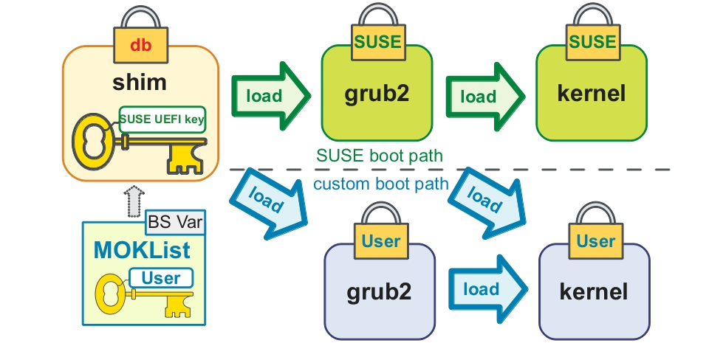
Load the UEFI image as long as it is trusted
Linux Update – Multiple OS Boot with MOK

Slide 36
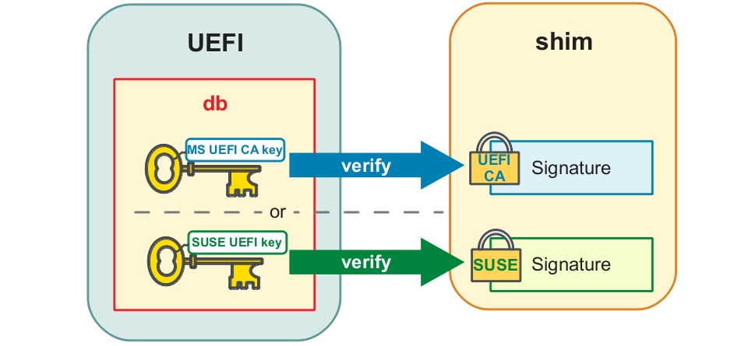
Either the UEFI CA key or SUSE key will let the shim boot with UEFI secure boot
Multi-Signature Support for Shim

Slide 37
RandomNumberGenerator
UEFI driver implementing the EFI_RNG_PROTOCOL from the UEFI2.4 specification
TCG
PEI Modules & DXE drivers implementing Trusted Computing Group measured boot
EFI_TCG_PROTOCOL and EFI_TREE_PROTOCOL from the TCG and Microsoft MSDN websites, respectively
UserIdentification
DXE drivers that support multi-factor user authentication
Chapter 31 of the UEFI 2.4 specification
Library
DxeVerificationLib for “UEFI Secure Boot”, chapter 27.2 of the UEFI 2.4 specification + other support libs
VariableAuthenticated
SMM and runtime DXE authenticated variable driver, chapter 7 of the UEFI2.4 specification
https://svn.code.sf.net/p/edk2/code/trunk/edk2/SecurityPkg
UDK2014 SecurityPkg

Slide 38
Variable Lock Protocol
Make variables read-only https://github.com/tianocore/edk2/blob/master/MdeModulePkg/Include/Protocol/VariableLock.h
Lock Box
Protect content across re-starts
https://github.com/tianocore/edk2-MdeModulePkg/blob/master/Include/Protocol/LockBox.h
Capsule Update
Generic capsule update driver support
http://comments.gmane.org/gmane.comp.bios.tianocore.devel/8402
https://svn.code.sf.net/p/edk2/code/trunk/edk2/
Additional capabilities in the open source

Slide 39
Analyze and Mark external Interfaces where input can be attacker controlled data, comment headers
/**
Install child handles if the Handle supports GPT partition structure.
Caution: This function may receive untrusted input.
The GPT partition table is external input, so this routine
will do basic validation for GPT partition table before install
child handle for each GPT partition.
@param[in] This Calling context.
@param[in] Handle Parent Handle.
@param[in] DevicePath Parent Device Path.
**/
EFI_STATUS
PartitionInstallGptChildHandl
UDK2010 example: http://edk2.svn.sourceforge.net/svnroot/edk2/trunk/edk2/MdeModulePkg/Universal/Disk/PartitionDxe/Gpt.c
Code Management

Slide 40
CPU/SOC
(Intel)
Start Block PEI
(OEM)
BIOS DXE/UEFI
(OEM)
OS Loader/Kernel
(OSV)
Intel Boot Guard
Executable
Executable
Executable
Enforces
Enforces
Enforces
Policy Engine
Policy Engine
Policy Engine
Policy
Policy
Policy
Intel® Device Protection Technology with Boot Guard
http://www.intel.com/content/dam/www/public/us/en/documents/product-briefs/4th-gen-core-family-mobile-brief.pdf
OEM PI Verification
Using PI Signed
Firmware Volumes Vol 3, section 3.2.1.1
of PI 1.3 Specification
OEM UEFI 2.4 Secure Boot
Chapter 27.2 of
The UEFI 2.4 Specification
Intel® Boot Guard

Slide 41
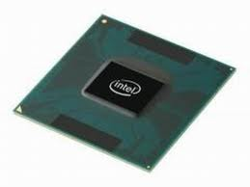

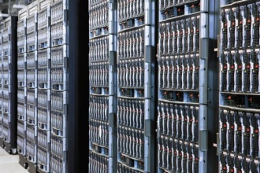
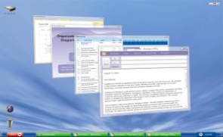
Technologies – putting it together
Reset
Assets
Threats
BIOS Flash
ROM Swap
Bit rot
H/W
Spec
TCG Measurements into PCRs 0..7
System BIOS
NIST SP800-147. PEI recovery. DXE SMM, UEFI Core
Erase flash part
Overwrite flash part
SP800 -147
Option ROMs
BIOS device drivers
Erase op ROM
Overwrite op ROM
UEFI 2.4
Network Boot
IPv6 for the cloud
Network attacks
OS Boot loader
BIOS loads the OS To BIOS, VM is an OS
Spoof boot loader
Different colors for different vendors

Slide 42
Trust Model

Slide 43
System
Data | CP/M (1974) | IBM PC (1981) | PC (1999) | PC (2012)
BIOS ROM | <4K | 40K | 512K | 4M
Processor | 8080 | 8088 | Pentium III | Ivy Bridge
OS | CP/M | DOS | Win98 | Win8

Slide 44
Security
Data | CP/M (1974) | IBM PC (1981) | PC (1999) | PC (2012)
Malware | [1949]: John von Neumann - Theory of self-reproducing automata [1971]: Bob Tomas: Creeper - “I’m Creeper: Catch me If you Can” | [1984]: Fred Cohen- Computer Viruses - Theory and Experiments (VAX, UNIVAC) [1986]: Farooq Alvi – Brian (IBM PC) | [1999]: CIH (Intel 430TX) | [2011]: BMW /Mebromi (Award BIOS) *[2005~] BootKit *[2006~] BiosRootkit *[2006~] SMM *[2008] Password *[2008~] NIC *[2009] BMP *[2009] ME *[2009~] KBC/EC *[2011] Battery Bootkit S3 SMM
Security | [1972] Anderson - Computer Security Technology Planning [1973] Bell-LaPadula [1977] Biba Integrity [1989] Clark Wilson | Bios Password | Flash Protection [1992] SMM in i486SL | [2003] TCG [2006] TXT [2006] UEFI Secure Boot [2009] SMRR [2014] Intel ® Boot and BIOS Guard

Slide 45
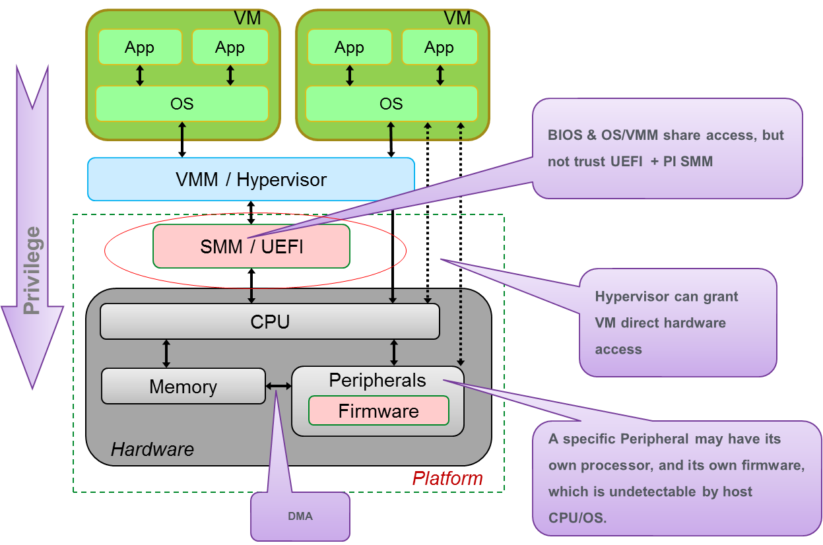
Security Challenges
Different elements in platform from many vendors
How to establish trust anchor in the hardware
How to protect elements
How to protect the platform
How to allow platform scaling

Slide 46

BIOS Potential Attack Surfaces
Shell
Apps &
Diags
Unsafe
Coding
Practices
Option
ROMs
BIOS
Standard
APIs
Server
Mgmnt
Interfaces
System
Mgmnt
Mode
BIOS
Update
Interfaces
BIOS
Vendor
Hooks
Notes:
(Pitfall)
Field Updatable
BIOS, like other firmware, often needs to be updated in the field post-deployment.
Standard APIs
BIOS unlike many other custom firmware implementations is more and more being developed using standard UEFI interfaces.
These are published (hint, hint)
Intimate Platform control Points
Subverting BIOS opens up direct and deep handles on a platform which can be exploited without knowledge of higher-level software (SMM).
Option ROMs
Plug in that PCIe card and invite its Option ROM to the party.
OROM code pulled in by BIOS at boot time

Slide 47
BIOS Malware
UEFI Rootkits
Bootkits
SMM Rootkits
Device FW Malware
ACPI Rootkits
Option ROM Malware
Evil Maid
HVM Rootkits (Blue Pill)
HW Trojans
Pre-Boot Threats

Slide 48
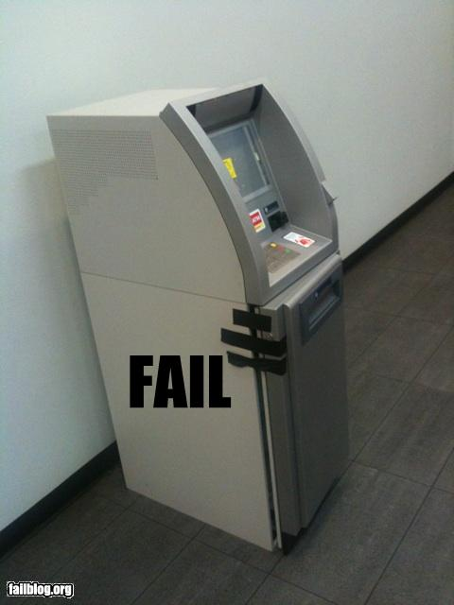
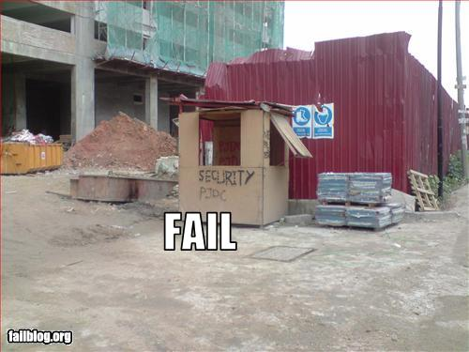
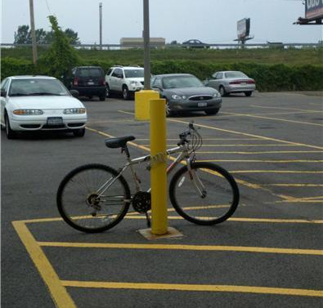
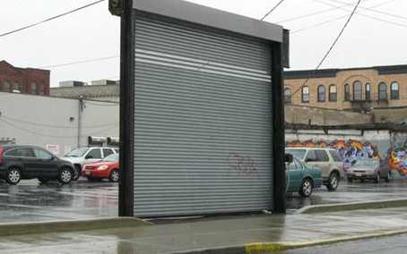
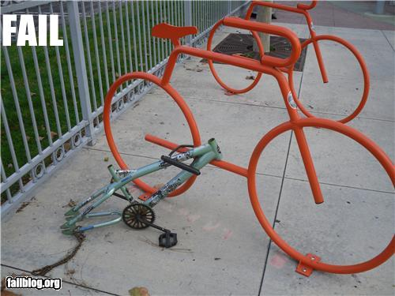


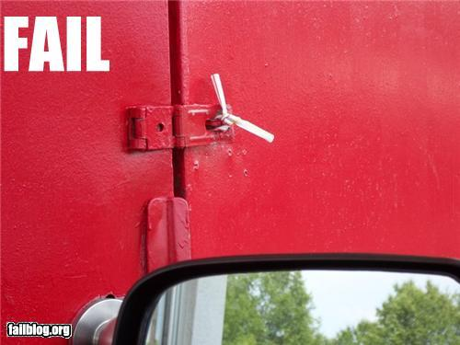
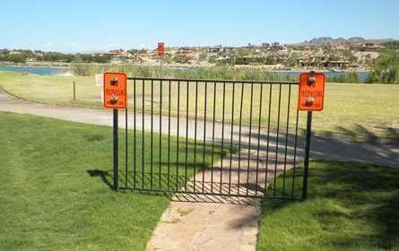
Missed a Detail
Source: Jeff Forristal

Slide 49
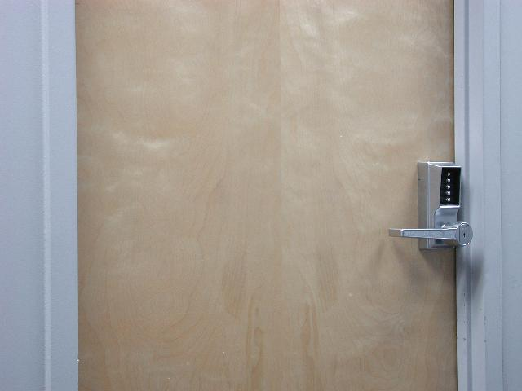
Security Fundamentals

Slide 50
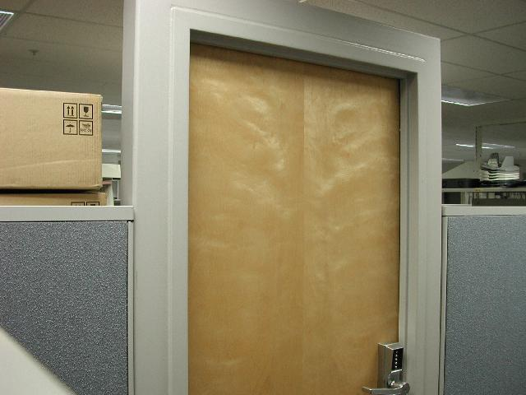
Security Fundamentals

Slide 51
What Could Possibly Go Wrong???
SMM Intrinsic Services
SMM Handler
Pre Verifier
UEFI Runtime, ACPI, SMBIOS,….
CPU Init
SMM IPL
verify
Exposed
Platform Interface
OS Absent Application
Chipset Init
Device, Bus, or Service Driver
Board Init
Transient OS Boot Loader
EFI Driver Dispatcher
Boot Manager
OS-Present App
Boot Services Runtime Services
Final OS Boot Loader
Final OS Environment
?
security
Security
(SEC)
Pre EFI
Initialization (PEI)
Driver Execution Environment (DXE)
Boot Dev
Select (BDS)
Transient System Load
(TSL)
Run Time
(RT)
After Life
(AL)
Power on
[ . . Platform initialization . . ]
[ . . . . OS boot . . . . ]
Shutdown

Slide 52
Things need consider
System
Firmware
Protect
Detect
Recover

Slide 53
What to build & defend – Rationale for a threat model
“My house is secure” is almost meaningless
Against a burglar? Against a meteor strike? A thermonuclear device?
“My system is secure” is almost meaningless
Against what? To what extent?
Threat modeling is a process to define the goals and constraints of a (software) security solution
Translate user requirements to security requirements
We used threat modeling for our UEFI / PI codebase
We believe the process and findings are applicable to driver implementations as well as UEFI implementations in general

Slide 54
Defining, using a threat model
A Threat Model (TM) defines the security assertions and constraints for a product
Assets: What we’re protecting
Threats: What we’re protecting it against
Mitigations: How we’re protecting our Assets
Use TM to narrow subsequent mitigation efforts
Don’t secure review, fuzz test all interfaces
Select the ones that are critical
TM is part science, part art, part experience, part nuance, part preference
Few big assets vs lots of focused assets

Slide 55
We don’t always get to choose our Assets
SMM
Boot flow
SMM
Operating System
Security “Researchers”
PE/COFF
Build tools
Source
Option ROM
BIOS Flash
Internal Research
UEFI, TCG, OSV
S3 → S0
NIST
This reg That reg Other bit
Internal Research

Slide 56
Flash**
NIST SP800-147 says
Lock code flash except for update before Exit Mfg Auth
Signed update (>= RSA2048, SHA256)
High quality signing servers
Without back doors (“non-bypassability”)
Threats
PDOS – Permanent Denial of Service
System into inefficient room heater
Elevation of privilege
Owning the system at boot is an advantage to a virus
Known attacks
CIH / Chernobyl 1999-2000
Mebroni 2010
Mitigations include
Reexamining flash protection methods – use the best even if its new
Using advanced techniques to locate and remove (un)intentional backdoors
** or tomorrow’s equivalent NV storage

Slide 57
SMM
SMM
SMM is valuable because
It’s invisible to Anti Virus, etc
SMM sees all of system RAM
Not too different from PCI adapter device firmware
Threats
Elevation
View secrets or own the system by subverting RAM
Known attacks
See e.g Duflot, Legbacore
Mitigations include
Validate “external” / “untrusted” input
Remove calls from inside SMM to outside SMM

Slide 58
Resume from S3
This reg That reg Other bit
ACPI says that we return the system to the S5→S0 configuration at S3→S0
Must protect the data structures we record the cold boot config in
Threats
Changing data structures could cause security settings to be incorrectly configured leaving S3
Reopen the other assets’ mitigated threats
Known attacks
Mitigations include
Store data in SMM -or-
Store hash of data structures and refuse to resume if the hashes don’t compare

Slide 59
Tool chain
Tools create the resulting firmware
Rely on third party tools and home grown tools
Incorrect or attacked tools leave vulnerabilities
Threats
Disabled signing, for example
Known attacks
See e.g. Reflections on Trust, Ken Thompson**
Mitigation
Difficult: For most tools, provided as source code
Review for correct implementation
Use static, dynamic code analysis tools
PyLint for Python, for example
** CACM, Vol 27, No 8, Aug, 1984, pp. 761-763

Slide 60
Boot flow
PE/ COFF
Secure boot
Authenticated variables
Based on the fundamental Crypto being correct
Correct location for config data
Threats
Run unauthorized op roms, boot loaders
PDOS systems with bad config variables
Known attacks
Mitigations include
Sanity check config vars before use, use defaults
Reviews, fuzz checking, third party reviews, etc.

Slide 61
TM to Modules: Boot flow
Var Svcs
Auth Var Svcs
PE/Coff Loader
Crypto
Authenticated Variables
boot control variables
File System
Setup Variables
USB Stack
ATAPI Stack
SCSI Stack
LAN Stack
USB Dev
ATAPI Dev
SCSI Dev
LAN NIC
Buff o’flow to pwn sys. Sanity check config pkts.
Classic net attacks Fuzz test packets

Slide 62
Assets or not?
Variable content sanity checking?
If you randomly fill in your Setup variables, will your system still boot?
Fit in as a part of boot flow
ACPI? We create it but don’t protect it
TPM support? We fill in the PCRs but don’t use them (today)
Quality ≠ Security
?

Slide 63
Vulnerability VS Threat
Vulnerability Cases:
Unauthorized Firmware Update
Unauthorized 3rd Party Code
Critical Register Unlocked
Buffer Overflow
Secret Used but not Cleared
Default Passphrase to Access
Threat:
S: Spoof user identity
T: Tampering
R: Repudiation
I: Information disclosure
P: Permanent Denial of Service
E: Elevation of privilege
D: Denial of service

Slide 64
EDK II on MinnowMax

Slide 65
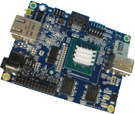
MinnowMax
Open hardware platform
Baytrail single or dual core
From http://firmware.intel.com/projects
This project focus in on the firmware source code (and binary modules) requried to create the boot firmware image for the MinnowBoard MAX. The UEFI Open Source (EDKII project) packages for MinnowBoard MAX are available at http://tianocore.sourceforge.net/wiki/EDK2. To learn more about getting involved in the UEFI EDKII project visit the How to Contribute page.
The source code builds using Microsoft Visual Studios and GNU C Compiler (for both 32 and 64 bit images) - production and debug execution environments. The source code builds the same UEFI firmware image shipping on MinnowBoard MAX.
- See more at: http://firmware.intel.com/projects#sthash.1oOc8srY.dpuf

Slide 66
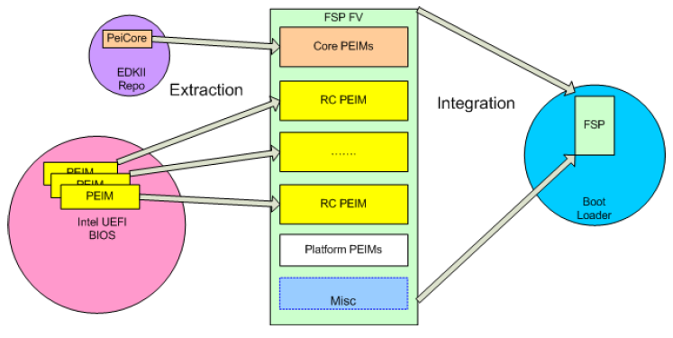
Intel® Firmware Support Package (FSP) Overview
The Intel ® FSP provides processor & chipset initialization in a format that can easily be incorporated into many existing boot loader frameworks without exposing the Intellectual Property (IP) of Intel.
Distributed as single binary
Silicon PEIMs packaged into FSP
Plugs into existing f/w frameworks
Binary customization
More information at www.intel.com/fsp

Slide 67

Intel® FSP Boot Flow
Reset
Vector
Parse Return Data
Load Microcode
Switch to 32-bit Mode
Platform Init
Temp Ram Init
Bus and Device Init
Mem Init
Find FSP Entry Point
Companion Chip Init
NotifyPhase
PostPciEnum
Jump to FSPinit
Boot Device Init
Processor Init
Load OS or other payload
NotifyPhase Code
Boot Loader
NotifyPhase
ReadyToBoot
FSP
App
Intel® FSP
Notes:
Boot loader owns reset vector
Bootloader contains the real mode reset vector handler code
Bootloader calls TempMemInit to create stack
Bootloader calls FspInit to initialize memory and chipset
Bootloader calls NotifyPhase at proper stages

Slide 68
MinnowMax
Focused on the maker community, but….
64-bit Intel® AtomTM E38xx Series SOC
Has UEFI Secure Boot
Built off of live tree
Ability to update w/ latest capabilities on http://www.tianocore.org

Slide 69
EDK II on Galileo

Slide 70
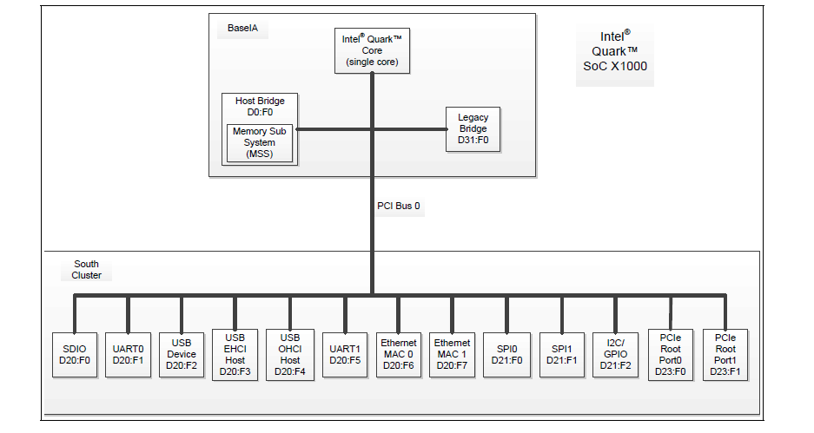
Intel® Quark™ SoC – Hardware Overview
32 bit Intel® Pentium® ISA-class processor
PCI
USB
I2C
Single core

Slide 71
UEFI for Intel® Quark™ SoC
First fully open source Intel-based platform
Builds on Intel® UDK2014 packages like MdePkg, MdeModulePkg w/ a 32-bit build, adding
IA32FamilyCpuBasePkg
QuarkPlatformPkg
QuarkSocPkg
Standard build is 1 Mbyte image w/full features
Capsule update, SMM, S3, PCI, recovery, full UEFI OS support, FAT OS support, UEFI variables
Notes:
Split into 2
Directory listing of packages used for quark/galileo

Slide 72
Quark and security
Support for I2C-attached TPM
Hardware Secure Boot option
UEFI Secure Boot implementation
UEFI Capsule update support w/ hardware verification assist
…..
Demonstrates one way to build out UEFI Security Features w/ a full open source platform tree

Slide 73
Futures

Slide 74
Integrity analysis of Pre-OS via Compartments – CW/BIBA
Business goals dictate isolation boundaries called compartments (cpts)
Platform Manufacturer wants to protect self from 3rd party pre-OS and OS/Hv
OS/Hv- protect self from pre-boot extensibility
Idealized isolation boundary is a compartment (cpt)–
Not a thing like process, interface table, handle etc
Security types are actual data types that are used in the cpt.
Eg: Smm_code_t, efi_iface_tbl_data_t in OEM cpt
Security analysis checks if something is a compartment
Checking a number of information flow rules
Code and data in compartment have verifiable integrity
Compartment needs storage isolated from other compartments
Compartment needs execution isolation
Compartment transitions have chokepoints and are protected via guards
Interfaces into the compartment for code and data must be validated
Admin model of compartment must be fully specified
Admin tasks must be “minimized” to reduce TCO & chance of bugs
Audit (e.g.,TPM measurements)– All integrity affecting operations must be audited
Availability of audit log is also a requirement

Slide 75
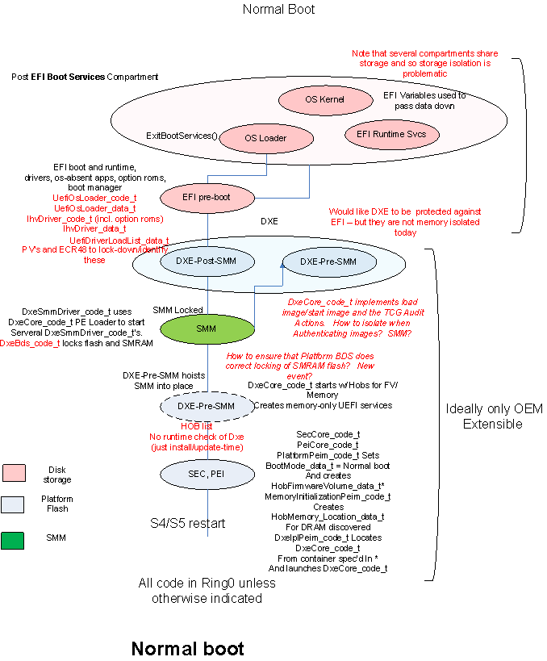
Notes:
Define isolation compartments to satisfy the goals
Analyze compartment isolation
Protection of code and data throughout compartment lifecycle
Protection of interfaces exposed by compartment
Compartment admin and policy data protection
Minimize admin tasks and code
Per-compartment audit (eg: using TPM)
Analysis mechanism
Define security types and roles for each compartment based on EFI architecture
Perform an information flow analysis to look for unguarded write flows from lower integrity compartments to higher integrity compartments
See XLS spreadsheet for full listing of compartment types
75

Slide 76
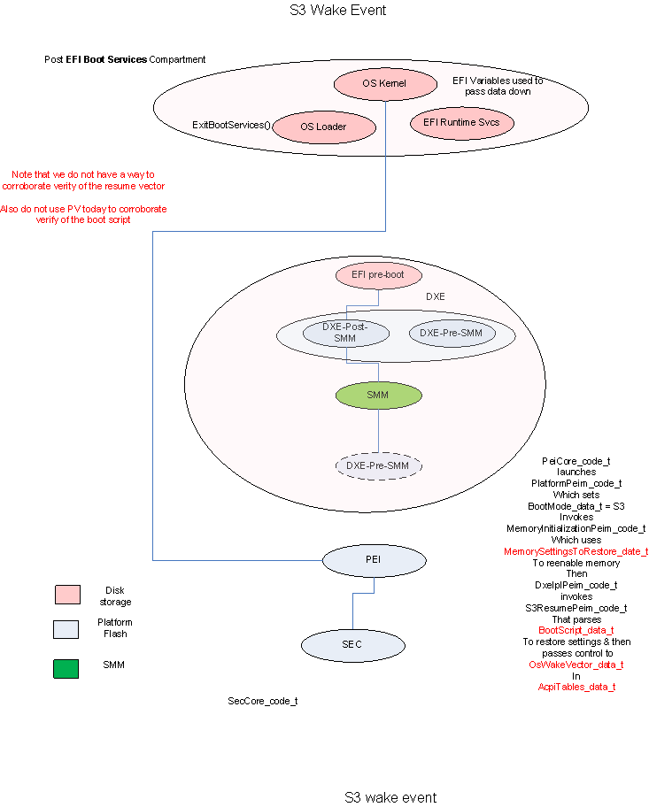
Notes:
Define isolation compartments to satisfy the goals
Analyze compartment isolation
Protection of code and data throughout compartment lifecycle
Protection of interfaces exposed by compartment
Compartment admin and policy data protection
Minimize admin tasks and code
Per-compartment audit (eg: using TPM)
Analysis mechanism
Define security types and roles for each compartment based on EFI architecture
Perform an information flow analysis to look for unguarded write flows from lower integrity compartments to higher integrity compartments
See XLS spreadsheet for full listing of compartment types
76

Slide 77
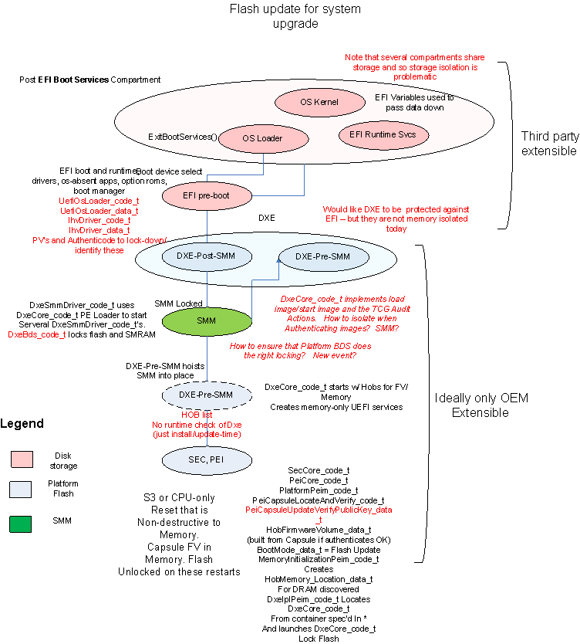
Notes:
Define isolation compartments to satisfy the goals
Analyze compartment isolation
Protection of code and data throughout compartment lifecycle
Protection of interfaces exposed by compartment
Compartment admin and policy data protection
Minimize admin tasks and code
Per-compartment audit (eg: using TPM)
Analysis mechanism
Define security types and roles for each compartment based on EFI architecture
Perform an information flow analysis to look for unguarded write flows from lower integrity compartments to higher integrity compartments
See XLS spreadsheet for full listing of compartment types
77

Slide 78
Moving Forward
More open source examples
Test tools complement the SCT, but the community can do more!
Continue to evolve development philosophy
“Testing shows the presence, not the absence of bugs” (Dijkstra,1970)
Better Living Through Tools? (Zimmer, 2013)
Getting code coverage closer to 100%?
Early effort using DDT with EDK II, Moving to KLEE (open source)
More fuzzers, from custom to public (e.g., Peach)
More Isolation – lots of hardware, esp. that built for OS/Hv. Leverage for platform firmware where it makes sense
Map the CW/BIBA CPT analysis to specs & code
Information flow and analysis
NX, ALSR, Stack Canaries

Slide 79
References
UEFI Forum http://www.uefi.org
EFI Developer Kit II http://www.tianocore.org
White papers, training, projects http://firmware.intel.com
CHIPSEC: https://github.com/chipsec/chipsec
Trianocore security advisories
UEFI Forum USRT (security@uefi.org , PGP key)
Intel PSIRT (secure@intel.com, PGP key)
Books http://www.apress.com/apressopen UEFI SHELL
UEFI Overview UEFI Intel Technology Journal
Quark Soc X1000 Version 1.1.0 BIOS https://downloadcenter.intel.com/download/23197/Intel-Quark-BSP
MinnowMax http://www.minnowboard.org/meet-minnowboard-max/

Slide 80
Thank You CanSecWest 2015

